Slide 1
Arabic Letters Review
Friday’s Lesson

Slide 2
One Way Connectors
Letters that can only be connected from one direction while being written.
و زذ د ا ر

Slide 3
ز
Pronounced as the S in the word ‘busy’
This letter starts above the line, but curves underneath the line.
English pronunciation is Zay
How to write your Zay:
Initial: ب Medial_______ Final connected: بز Final unconnected: رز

Slide 4
و
Pronounced as the w sound in ‘wet’ or the oo sound in ‘boot’
Starts above the line, but curves underneath the line.
English pronunciation is Waw.
How to write your Waw:
Initial: وب Medial: ______Final connected: بو Final unconnected: رو

Slide 5
ذ
Pronounced as the th in ‘then’
Stays above the line at all times
English pronunciation Thal
How to write your Thal:
Initial: وب Medial: بذب Final connected: بذ Final unconnected: رذ

Slide 6
د
Pronounced as the d in ‘dim’ or in ‘donkey’
Stays above the line at all times
English pronunciation Del
How to write your Del:
Initial: دب Medial: بدب Final connected: بد Final unconnected: رد

Slide 7
ا
Pronounced as the a in ‘dad’ and ‘far’
Stays above the line at all times
English pronunciation is Alif
How to write your Alif
Initial: اب Medial: باب* Final connected: با Final unconnected: را
*when connected the Alif acts as a long vowel sound for an a.

Slide 8
ر
Pronounced as the r in ‘thrilled’ and ‘rolled’
Starts above the line, but curves underneath the line.
English pronunciation is Ra
How to write your Ra
Initial: رب Medial: برب Final connected: بر Final unconnected: رر*
*the second Ra is just used as a filler letter to go infront of the letters when they are a final unconnected.

Slide 9
Two Way Connectors
These are letters that can be connected from both directions.
ب ت ث ن ي س ش ج ح خ ف ق

Slide 10
ب
Pronounced as the b in ‘ball’
Stays above the line at all times
English pronunciation is Ba
How to write your Ba
Initial: بت Medial: تبت Final connected: تب Final unconnected: رب

Slide 11
ت
Pronounced as the t in ‘trouble’
Stays above the line at all times
English pronunciation is Ta
How to write you Ta:
Initial: تب Medial: بتب Final connected: بت Final unconnected: رت

Slide 12
ث
Pronounced as the th in ‘thin’
Stays above the line at all times
English pronunciation is Tha
How to write your Tha
Initial: ثب Medial: بثب Final connected: بث Final unconnected: رث

Slide 13
ن
Pronounced as the n in ‘nine’
Starts above the line, but briefly dips under, then comes back up over the line again, unless it is in an initial or medial placement, in which case it would remain above the line completely
English pronunciation is Nun
How to write your Nun:
Initial: نب Medial: بنب Final connected: بن Final unconnected: رن

Slide 14
ي
Pronounced as the y in ‘yellow’
Starts above the line as the tail curls under the head and back out behind it, but ends still underneath the line, unless it is in an initial or medial position, in which case it would remain completely above the line.
English pronunciation is Ya
How to write your Ya:
Initial: يب Medial: بيب Final connected: بي Final unconnected: ري

Slide 15
س
Pronounced as the s in ‘seen’
While in an initial or medial placement the tail disappears and only the part that looks like a ‘w’ is seen, but when unconnected or as a final letter, the tail is kept and dips below the line and comes back up.
English pronunciation is Sin
How to write your Sin
Initial: سب Medial: بسب Final connected: بس Final unconnected: رس

Slide 16
ش
Pronounced as the sh in ‘sheep’
While in an initial or medial placement the tail disappears and only the part that looks like a ‘w’ is seen, but when unconnected or as a final letter, the tail is kept and dips below the line and comes back up.
English pronunciation is Shin
How to write your Shin
Initial: شب Medial: بشب Final connected: بش Final unconnected: رش

Slide 17
ج
Pronounced as either the g in ‘Gabe’ or the j in ‘jean’
While in an initial and medial placement it stays above the lines at all times, but if in a final or free standing position it will start above the line, but will curve underneath the line and will end there.
English pronunciation is jim

Slide 18
ح
Pronounced as a voiceless h sound as in the h in ‘who’
While in an initial and medial placement it stays above the lines at all times, but if in a final or free standing position it will start above the line, but will curve underneath the line and will end there.
English pronunciation is hakim

Slide 19
خ
Pronounced as a hard h sound, coming from the throat as in the ch in ‘challa bread’
While in an initial and medial placement it stays above the lines at all times, but if in a final or free standing position it will start above the line, but will curve underneath the line and will end there.
English pronunciation is kha

Slide 20
How to write your ج ,ح ,خ
When written in the initial or medial placement then they are written as so:
بحب
When written in a final placement it is written the same behind a one way connector and a two way connector:
بح رح
Be sure not to forget the proper dot placement.

Slide 21
ف
Pronounced as the f in ‘fat’
Remains above the line at all times
English pronunciation is Fa
How to write your fa:
Initial: فب Medial: بفب Final connected: بف Final unconnected: رف

Slide 22
ق
Pronounced as the q in ‘queen’ (minus the u part, like a throaty k sound)
Starts above the line, but briefly dips under, then comes back up again
English pronunciation is Qaf
How to write your QafL
Initial: قب Medial: بقب Final connected: بق Final unconnected: رق

Slide 23
Ta Marbuta ة
A variant of the ت , but serving only as a suffix
When following a two way connector it is written like so:
بة
When following a one way connector it is written as:
رة

Slide 24
Let’s practice
نَ+خْ+ت=
رِ+ي+م=
ذُ+و+ر+ي=

Slide 25
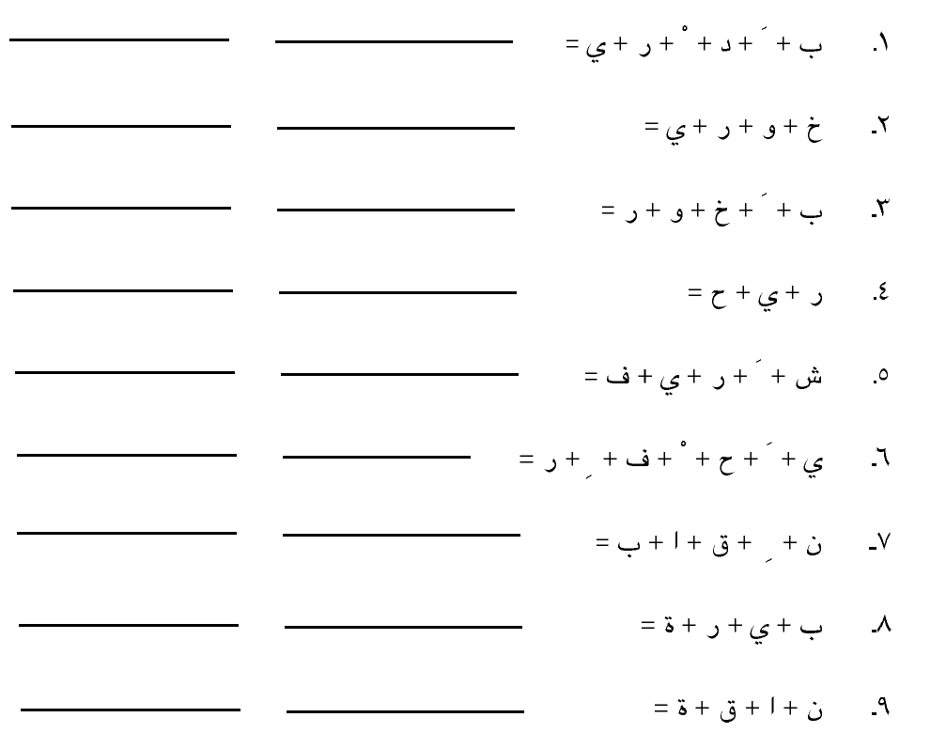
Write an appropriate transliteration to each; respect the vowels.

